Slide 1
Pharmacotherapy of OCD
C14
D11
D11
D11
D11
A11
D11
D11
Sean Sassano, M.D.
Adjunct Professor of Psychiatry
University of Southern California
Board of Directors Southern California Affiliate of the IOCDF
Diplomate American Board of Psychiatry and Neurology
Diplomate American Board of Addiction Medicine
seansassano@sassanomd.com

Slide 2
Disclaimer
This presentation is for informational purposes only. The information provided in this presentation is not a substitute for a visit with a medical professional. This presentation does not constitute a doctor-patient relationship.
Dr. Sassano does not have any financial relationships to disclose.

Slide 3
Objectives
1. First line medications

Slide 4
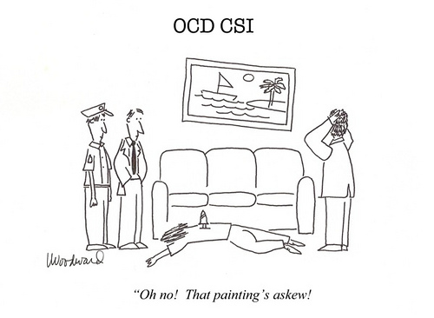
OCD Gets In the Way of Life

Slide 5
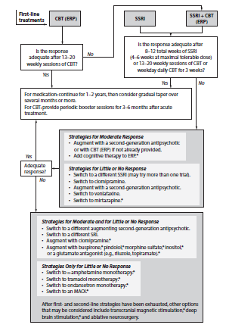
APA
Treatment
Guidelines

Slide 6
Pt doesn’t want medication
Medication difficult to implement
Able to participate in therapy
Pt doesn't have time for therapy
Therapy not available
Therapy too difficult
Severe
symptoms
Comorbid symptoms

Slide 7
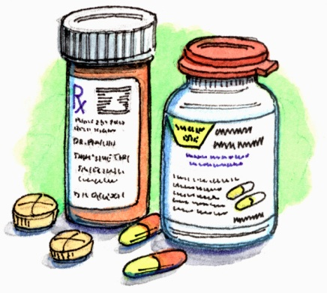
Medications
Advantages
Just take a pill every day
Don't need to see your clinician very frequently
Useful option when there isn't a therapist available
Disadvantages
Side effects
May need to try several different medications
Interactions with other medications
Stigma

Slide 8
FDA Approved OCD Meds
Fluoxetine (Prozac)
Paroxetine (Paxil)
Sertraline (Zoloft)
Fluvoxamine (Luvox)
Clomipramine (Anafranil)
*We use many other meds off-label for OCD*

Slide 9
How Effective are SSRIs?
20% response to any SSRI
(35% symptom reduction)
Response rate declines as you try more meds
Declining response rate does not mean patient is developing a resistance to SSRIs. Means SSRI is not the correct mechanism for improvement.
Skapinakis 2016

Slide 10
Which SSRI is Best?
Meta-analyses say…
They are all equal
No one SSRI is more effective
than any other
Skapinakis 2016

Slide 11
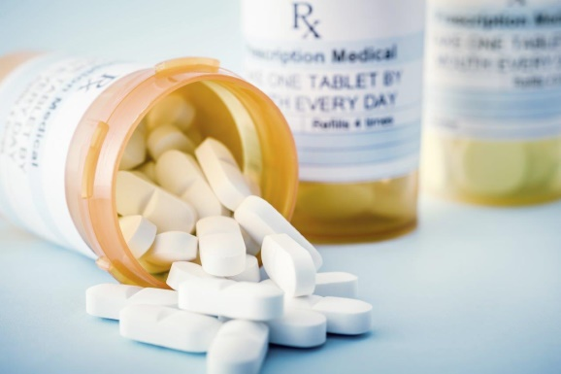
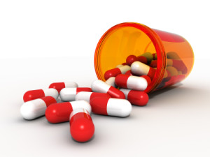
How to Choose an Initial Medication
Past trials-SE, what worked, what didn't
Genetics-What worked for a family member
Medication Characteristics- Potency of med/Precision of dosing/Liquid
Comorbidities-Depression, Tics, ADHD, OCDR, Seizures, Bleeding issues, Other medical issues
Side effects- Weight gain, weight loss, sleep, energy

Slide 12
How Long Before an Effect?
Up to 12 weeks is often needed to see an effect
25% of pts will benefit if wait 28 weeks
Meta-analysis: Greatest incremental benefits by week 6
Issaria 2016

Slide 13
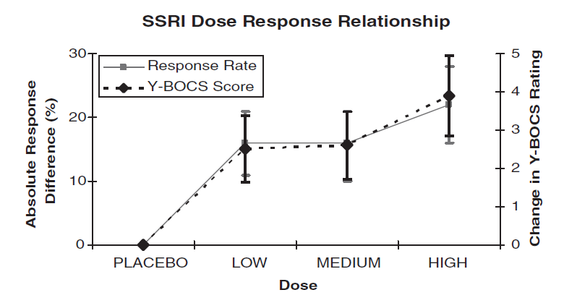
How High to Go
Higher doses more effective than lower doses
Bloch 2010

Slide 14
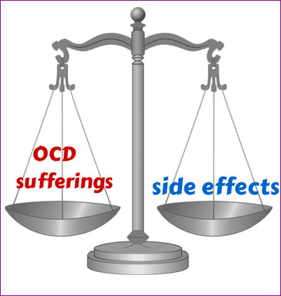
Side Effects of SSRIs
Most common: Nausea, headache, insomnia, sexual
Soomro 2008

Slide 15
Medication Options OCD
SRIs: SSRIs, SNRIs, Clomipramine (best evidence)
Mirtazapine (good evidence). May speed response if used for augmentation
Dopamine antagonists/partial agonists (good evidence)-should have lab monitoring
Benzodiazepines (helpful, not recommended as monotherapy)
Glutamate modulators-riluzole, memantine, N-AC, Topiramate, d-cycloserine 2 hours prior to ERP (fair-decent evidence for all), lamotrigine, ketamine
Mood stabilizers-Topiramate, gabapentin, pregabalin , valproate, lamotrigine (some evidence)
Nutraceuticals-NAC, inositol, tryptophan (some evidence)
Adjuncts-alpha-1 antagonists /alpha 2 agonists (really just for tics, can be helpful for anxiety)
Opiates/Opiate antagonists (small amount of evidence for the former, anecdotal evidence for the later/good for BFRP)
B-blockers/buspirone (fair evidence)
Stimulants/caffeine (some evidence)
Ondansetron (small amount of evidence)
Naltrexone-not effective?

